Slide 1
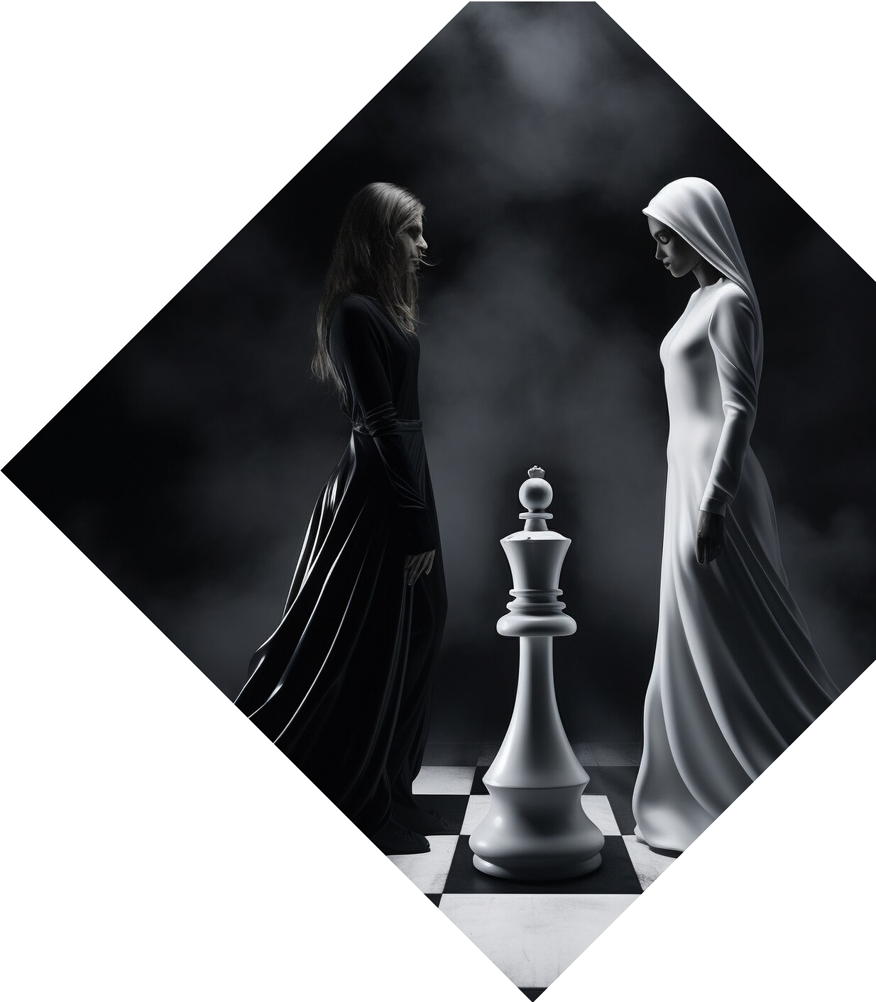

Visualizing the N- Queen Problem: A C++ Approach

Slide 2


Introducing the N- Queen Problem
The is a classic
constraint satisfaction problem in computer science, where the task is
to place queens on an
chessboard such that no two queens
attack each other.

Slide 3


Visualizing the N-Queen
Solution
Visualizing the solutions to the N- Queen problem can provide valuable insights into the problem's complexity and the various strategies used to solve it. This can be achieved
through
and
.

Slide 4


The C++ Approach
In this presentation, we will explore a
of the N-Queen problem, focusing on the algorithms, data structures, and techniques used to solve
this challenge efficiently. We will discuss the and its
implementation in C++.

Slide 5
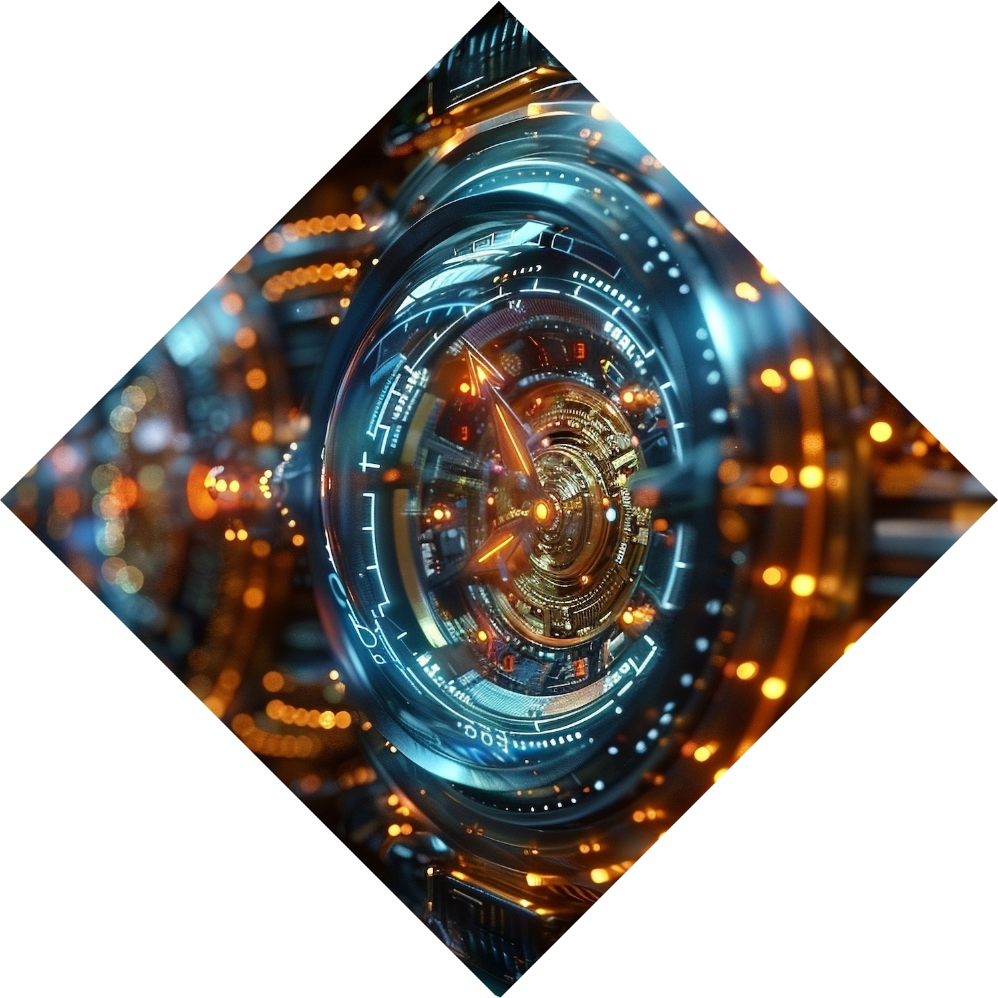
Backtracking Algorithm
The is a
fundamental technique used to solve the N-Queen problem. It involves recursively building candidates to the solutions and checking if each candidate satisfies the problem's statement. If a candidate does not meet the requirements, the algorithm backtracks to explore alternative
solutions.

Slide 6




Optimizing the Solution
To optimize the solution, we can explore various techniques such as
, ,
and .
These optimizations can significantly improve the performance and scalability of the N-Queen solution.

Slide 7



Handling Large N Values
As the value of increases, the complexity of the N-Queen problem grows exponentially. We will discuss strategies to handle larger N values, including the use of
, , and
.

Slide 9






Applications of the N-Queen Problem
The N-Queen problem has various
applications in
, and be used to explore
.
,
. It can
,
, and

Slide 10





Conclusion: Mastering the N- Queen Problem
In this presentation, we have explored the
, its , and
various . By
understanding the problem and its solutions, we can enhance our skills in ,
, and .

Slide 11
Thanks!
Do you have any questions?
youremail@email.com
+91 620 421 838
www.yourwebsite.com @yourusername

